Slide 1


Slide 2


Slide 3
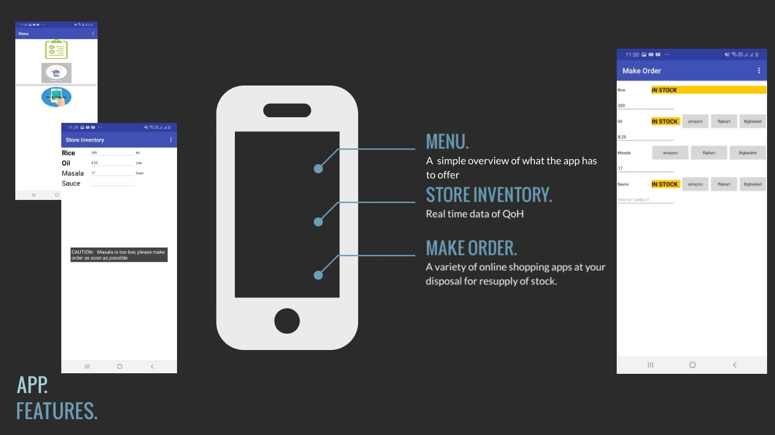

Slide 4
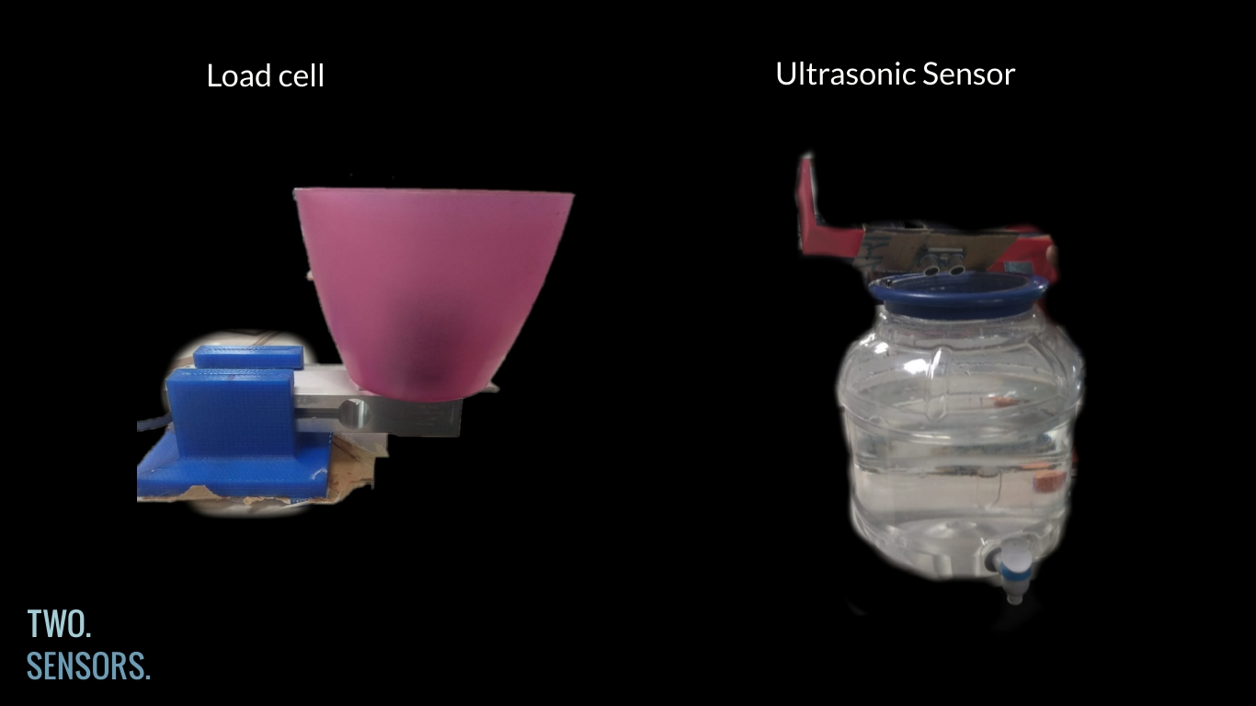

Slide 5
DRITI
TEAM MEMBERS:
JANANI SREE .T
AJAY .M
YOKKESH .S
GOMATHI .R
Our project is available at – https://github.com/GomathiRaveendran/Driti

